Slide 1

Digital Digital Twins
Some Experiences
Dr Marc Roper
Dept. Computer and Information Sciences
University of Strathclyde
Glasgow, UK
SANS II – 2nd-3rd May 2024

Slide 2
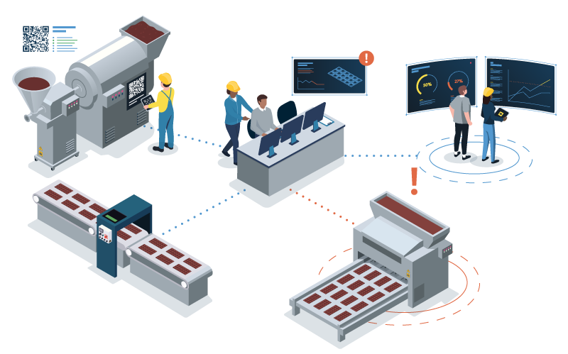
Digital Digital Twins?
Digital twins traditionally create a mapping between physical and virtual systems
“A … high-fidelity model of the system which can be used to emulate the actual
system.”
Digital digital twins create a mapping between virtual systems and virtual systems
Few instances of these

Slide 3
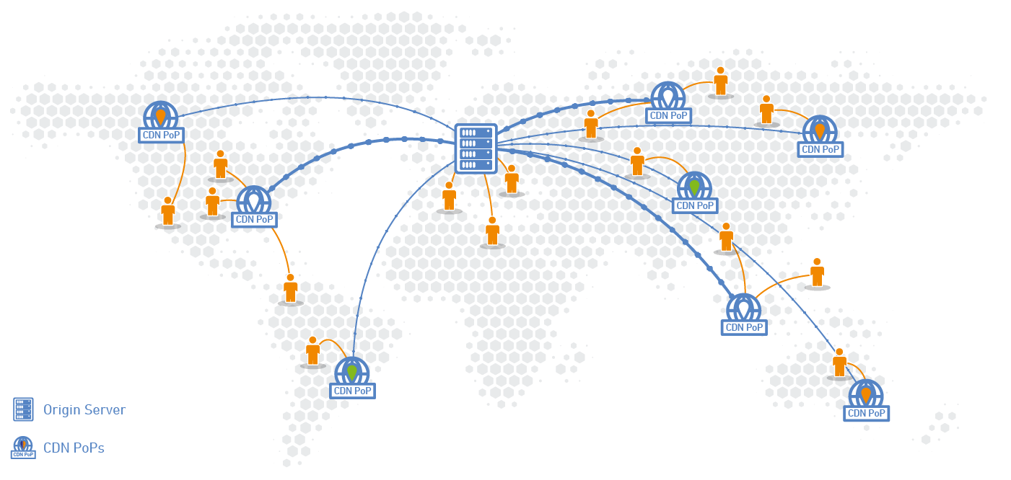
Why do we need them?
Actual system may be too large/slow/complex/expensive… to provide answers in the time/budget available
e.g. a CDN
Need an approximation to the system to allow us to perform the necessary computations
e.g. Evaluate different configurations in the case of the CDN

Slide 4

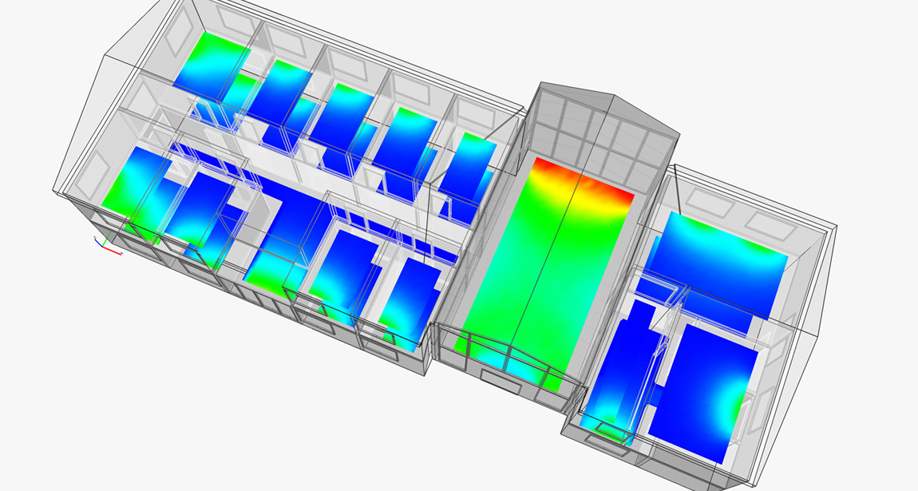
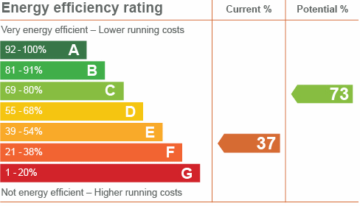
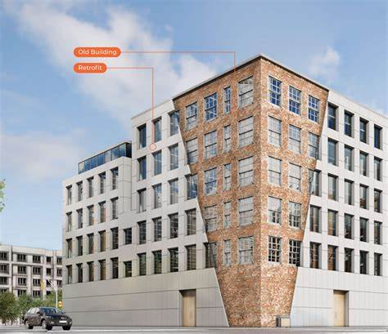
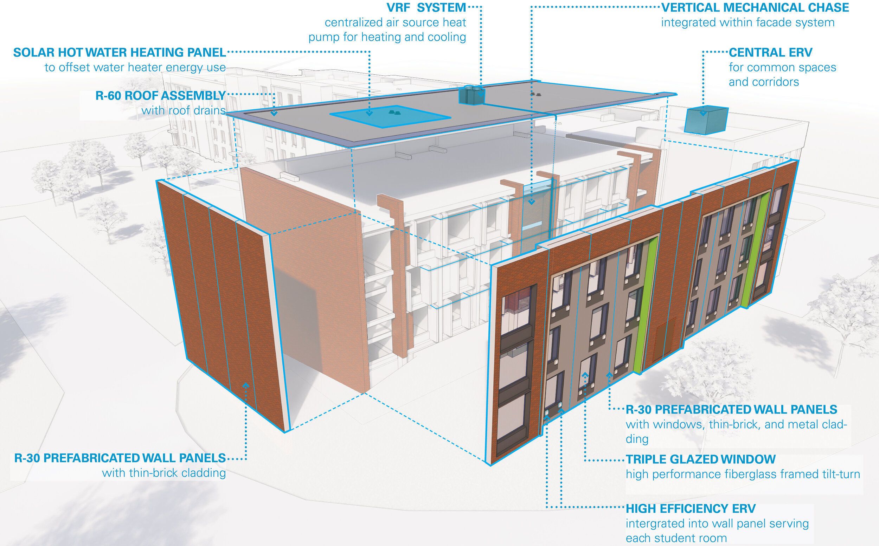
Predicting Building Energy Performance
(Data Lab funded in conjunction with Architecture)
Commercial buildings need to meet strict energy performance standards
Retrofitting – process of upgrading the building
Huge number of options
Clients need to know the cost/benefit analysis
Multi-objective optimisation problem
Software available to simulate possible changes took days to run
Notes:
4

Slide 5
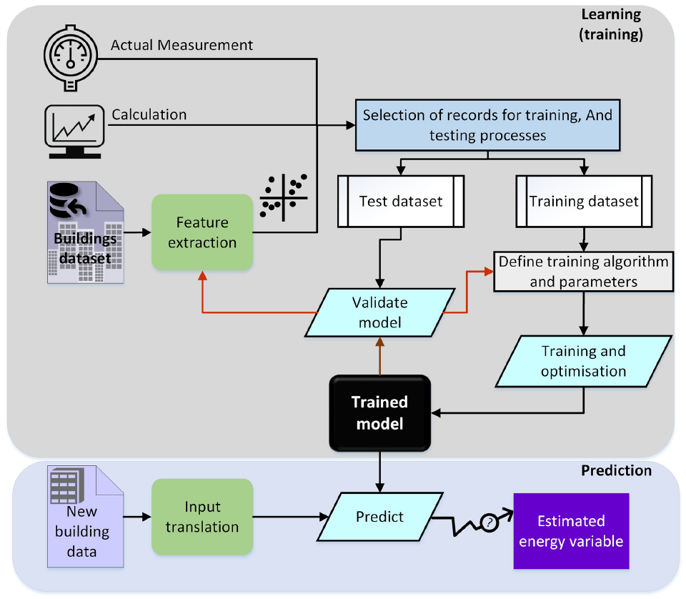
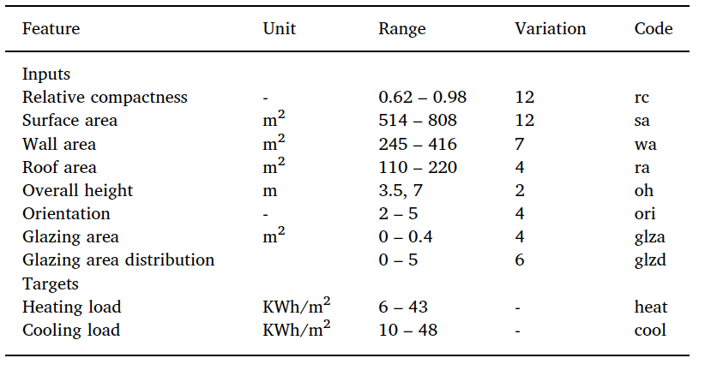
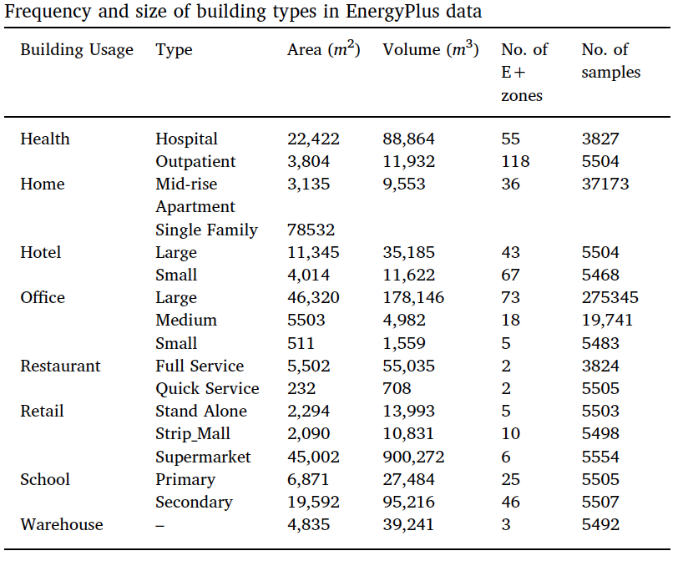
Predicting Building Energy Performance
Explored the performance of a range of machine learning models against two Building Performance Simulation tools: EnergyPlus and Ecotect
Datasets already existed for both tools covering a variety of climate conditions, building types and parameters
Also carried out feature engineering to reduce size of input space
Notes:
5

Slide 6
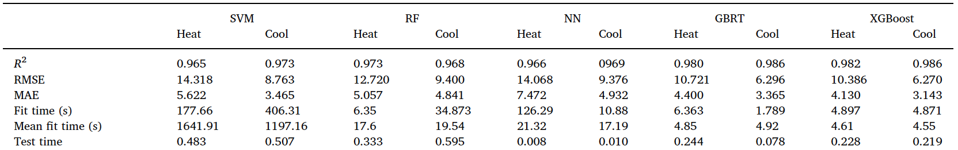
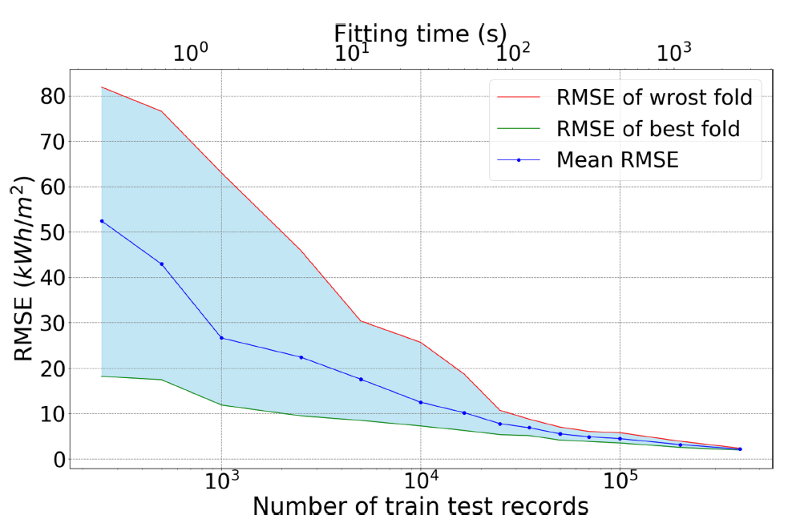
Predicting Building Energy Performance
Compared a range of models :
ANN, SVM, GP, RF and GBRT
Evaluated performance on heating and cooling over 25,000 data points (simulations)
Some variation between models:
GBRT and XGBoost most accurate
SVM longest training time
NN and XGBoost require a large amount of training data
NN fastest prediction time
End result is a model that can rapidly produce a set of approximate results that can be shortlisted and explored by the full model for higher accuracy
Notes:
6

Slide 7
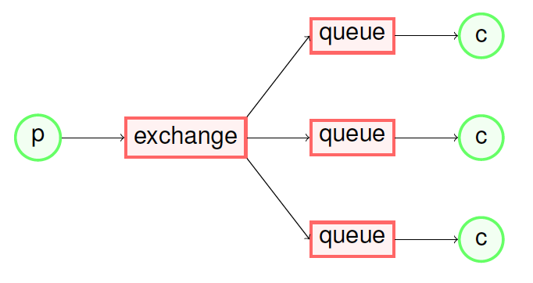
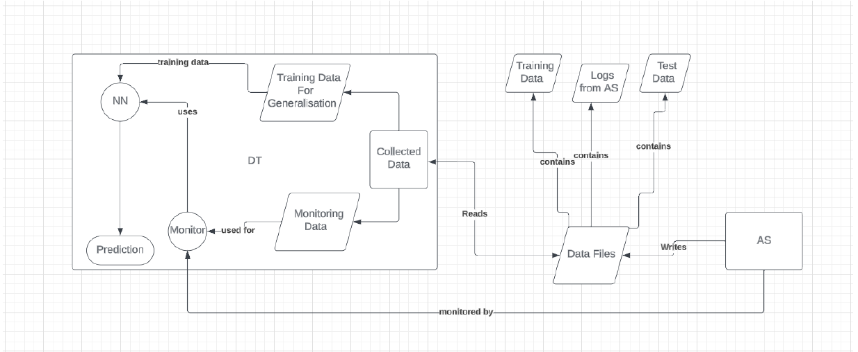
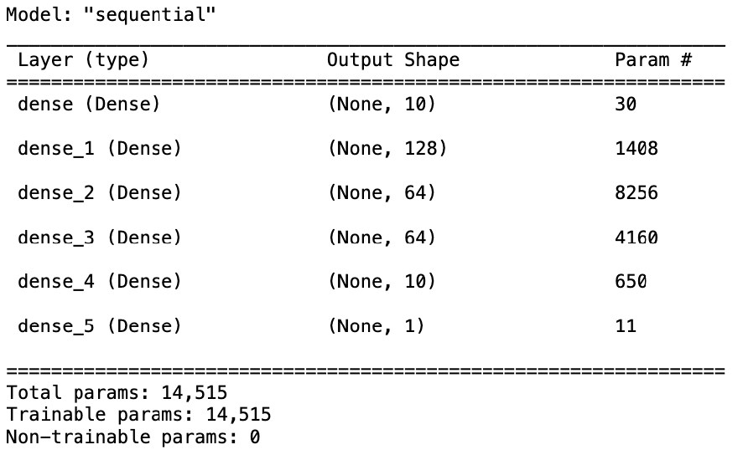
RabbitMQ message broker
Measured:
System Latency
Processing Time
Response Time
Message Delivery rate
Instances of Node Failure
DT based on a NN model
Trained on approx. 1200 instances
Notes:
7

Slide 8
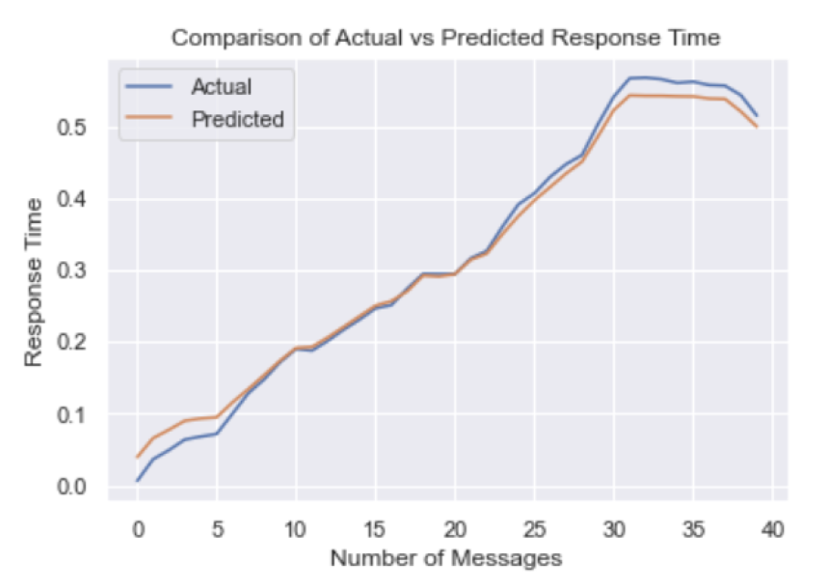
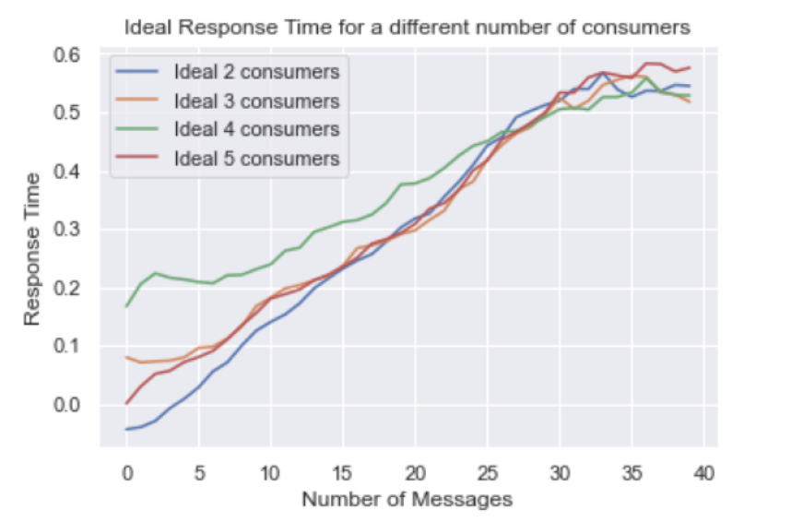
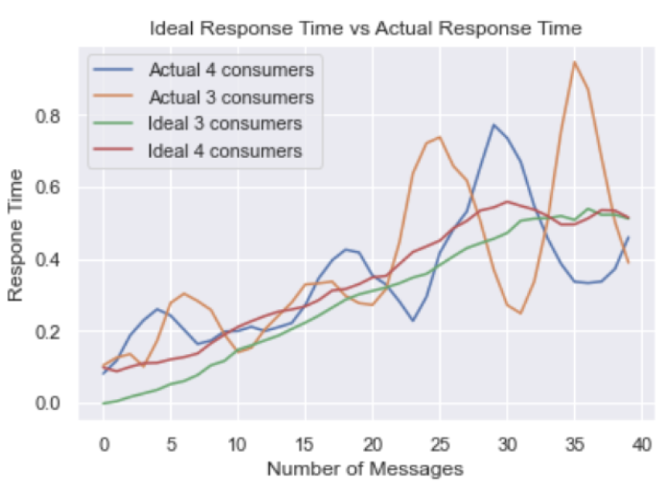
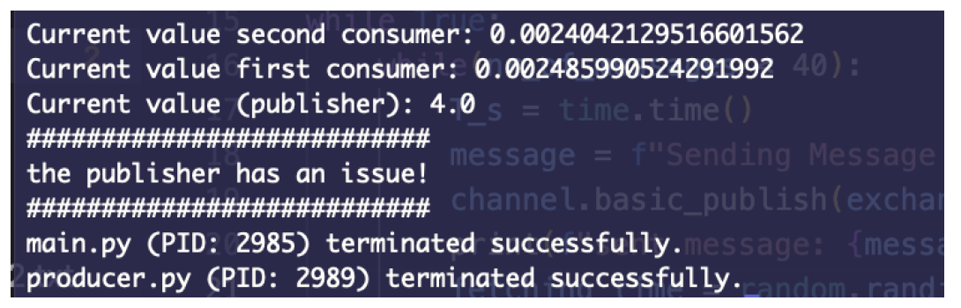
RabbitMQ message broker
Good degree of accuracy when predicting response time
“Descriptive, predictive, and prescriptive”
Able to predict responses for unseen configurations
Also able to use variations from predictions to identify problems
Notes:
8

Slide 9
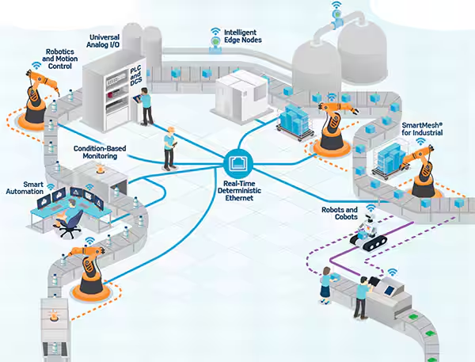
Challenges in building digital digital twins
No obvious instrumentation points
What do we measure to best characterize the system?
Generating data can be expensive
How do we know…
What test scenarios to use
When we have enough data
…to accurately characterise the system (response surface)?
Notes:
9

Slide 10
https://feuernursingreview.teachable.com/p/feuer-nclex-rn-qbank

